Slide 1
STUDENT ARTIST MEETING
SEPTEMBER 23, 2026

Slide 2
WHAT IS WAM?
  WAM (Wesleyan Arts Market) is an annual Artist fair that raises money for the Fine Arts Program
  Over 85 professional artists sell their work! We have many repeat professional artists from year to year. 30% of sales goes to Wesleyan Fine Arts
  Students are also invited to participate, giving back 10% of their sales to the Arts Alliance. It is a great way to showcase your work to the community while supporting your school
  WAM will be held Friday, April 23rd – 9-7& Saturday April 24-10-3

Slide 3
WHAT IS THE PROCESS?
Student Applications open November 1st – December 1st
Where do I find the link to apply?
On our website
Instagram page
Some teachers will email it
When applying, please select your booth set-up
2 X 4 Table
2X4 Table with two black grids for hanging artwork

Slide 4
Group Submission
Choose one student/parent combo to be the main communication contact.
This person will submit the application for the group under his/her name
This student/parent assumes responsibility for forwarding all communications to the rest of the group
Groups of two are common, groups of three are allowed but not recommended due to space both on and behind the 2 x 4 table
If applying as a group, everything is combined
One inventory submission from main contact
One check mailed to main contact

Slide 5
What if I want to make a food item?
Food Submission
All food artists will need to submit a food sample as part of their application
Food can be dropped off any time Dec 1-4, but will not be sampled until Friday (make provisions for this, I.e. shelf stable)
Samples are due at Cole Hall Front Office no later than 7:45 AM on Friday, December 4th
A food sample form must be filled out and turned in with submitted samples. This form will be made available by November 1st.

Slide 6
How does the team decide?
How is Participation in the Artist Market Determined?
Space
We have room for about 20 student artist booths.
Prioritized Order – focus on original creation by students
Original Student Art ( no amazon ordering )
Paintings, sculptures, photography, etc.
Original Student Creations
Food, Hand-made Jewelry, Hand-made Crafts
Original Student Compilations
Gift baskets, Assembled Jewelry, assembled Crafts.
Note – space ran out in this category for the 2026 Market
Adherence to Rules and Deadlines listed in the application

Slide 7
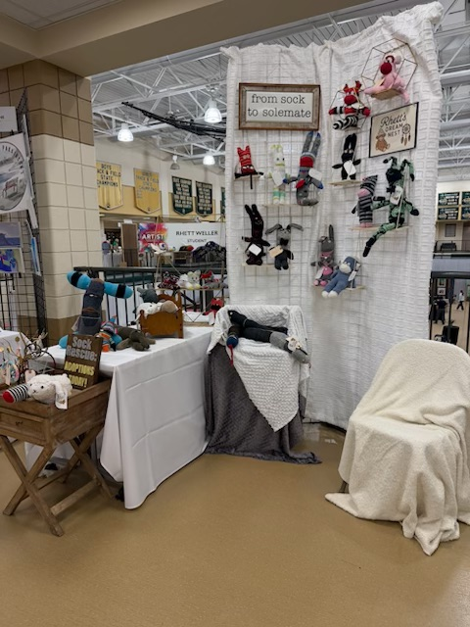
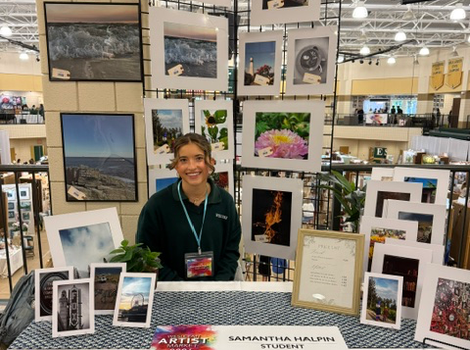
Example Art
Caption
Caption
Caption

Slide 8
What is not allowed at WAM?
What is not allowed at the Artist Market?
Completed products purchased elsewhere
Printed materials NOT designed by students
Wesleyan copyrighted logos

Slide 9
FINAL DETAILS
Participating booths will contribute $25 towards hospitality costs
Artist Market Dates –Thursday April 22nd – set up day, 7:00- 5:00
Friday, April 23rd – 9:00-7:00
Saturday, April 24 – 10:00-3:00
Someone must be present at the booth at all times Friday and Saturday
Students are not allowed to miss class to set up or sell. All participating students must recruit a parent/trusted adult to oversee the booth during school hours.
A mandatory student and parent meeting for all participants will be held in January to go over in further detail all logistical details, inventory instructions, and expectations.

Slide 10
Decision Day!!
What happens if I am invited to participate in the 2027 Artist Market?
Decisions will be emailed by December 16th
QUESTIONS?

